Slide 1
PHP SERVER SIDE RESTFUL API LUMEN
SERVER SIDE
2016
Name: Vu Quang Son

Slide 2
Table of content
Versioning
Routing
Filter, sort, search, paging
Json format
HTTP Status Code
Other best practices

Slide 3
Versioning
  /api/v1
  /public/api/v1/apps

Slide 4
Versioning (Best Practices)
  API Version is always required
  Use simple number (1, 2, …) & avoid dot such as 2.5
  Versioning starting with the letter “v”
  Server and Client use the same version level (1, 2, 3…)
  Server self-control the subversion internally (v1.1, v1.2…)

Slide 5
Routing (cont)
GET /answers - Retrieves a list of answers
GET /answers/12 - Retrieves a specific answer
POST /answers - Creates a new answers
POST /answers/update/12 - Updates answer #12
POST /answers/destroy/12 - Deletes answer #12
=> Use only GET & POST methods, some shared hosting do not support PUT, DELETE, PATCH or other methods

Slide 6
Routing
(Advantages & Best Practices)
  Use nouns not verbs
  Use only plural nouns

Slide 7
Routing
(Discussion)
  How about custom routes?
    GET /apps/filter
    GET /apps/related
  How about routes with multiple words
    Use dashes ( - ) for words delimiter
  Deal with multiple objects
    POST /answers/create – create multiple
    POST /answers/edit – update multiple
    POST /answers/remove – remove multiple

Slide 8
Routing
(Discussion)
  Deal with relations?
    GET /apps/12/questions
    GET /questions?app_id=12 => use this
    GET /apps/12/questions/14/medias
    GET /medias?app_id=12&question_id=14 => use this
    Use only single route and flexible query parameters produce flexible apis

Slide 9
FILTER, SORT, SEARCH, PAGING
  FILTER
    Use unique query parameter for each field that implements filtering
    Use database fields for faster implementation
    GET /apps?status=draft
    GET /apps?status=published&featured=1

Slide 10
FILTER, SORT, SEARCH, PAGING
  SORT
    Defined constant sort
    Parameters delimiter by comma (,)
    -created_at for DESC
    create_at for ASC
    GET /apps?sort=-created_at,id

Slide 11
FILTER, SORT, SEARCH, PAGING
  SEARCH
    Defined constant q for searching
    GET /apps?q=“IBM test”

Slide 12
FILTER, SORT, SEARCH, PAGING
  PAGING
    Defined constant limit and offset
    Default limit = 10 & offset = 0
    /apps?limit=20&offset=10
    Want no limit?
      /apps?limit=
      /apps?limit=0

Slide 13
FILTER, SORT, SEARCH, PAGING
  Limit fields returned by API
    Defined constant fields
    GET /apps?fields=id,title,created_at
    Only fields that listed are returned in JSON response

Slide 14
JSON FORMAT (Success)
  Get all:
  {
  "errorCode": null,
  "message": null,
  "result": {
  “total”: 15,
  “list”: [
  { }, { }
  ]
  }
  }
  Get single:
  {
  "errorCode": null,
  "message": null,
  "result": { }
  }
=> Result is always an object { }

Slide 15
JSON FORMAT (Error)
  {
  "errorCode": "validation_error",
  "message": {
  "icon": [
  "The selected icon is invalid."
  ],
  "background": [
  "The selected background is invalid."
  ]
  },
  "result": null
  }

Slide 16
AVOID BAD PRACTICE
  {
  "errorCode": "validation_error",
  "message": null,
  "result": [
  1: { },
  2: { }
  ]
  }

Slide 17
HTTP STATUS CODE
  200 OK – successful GET, PUT, DELETE
  201 Created – successful POST in creation
  204 No Content – successful request like DELETE
  304 Not Modified – for caching
  400 Bad Request – malformed request, cannot parse
  401 Unauthorized – invalid authentication
  403 Forbidden – do not have access
  404 Not Found – resource doesn’t exist
  405 Method Not Allowed – not implemented/not allow
  412 Precondition Failed – validation header
  422 Unprocessable Entity – validation body
  429 Too Many Requests – reject due to rate limit
  500 Internal Server Error – server error
Notes:
https://github.com/FriendsOfCake/crud/issues/337

Slide 18
HTTP STATUS CODE
(Discussion & Improvement)
  Using 201 Created – for successful POST in creation instead of 200 OK
  Using 422 Unprocessable Entity – for validation error instead of 412 Precondition Failed
Notes:
https://github.com/FriendsOfCake/crud/issues/337

Slide 19
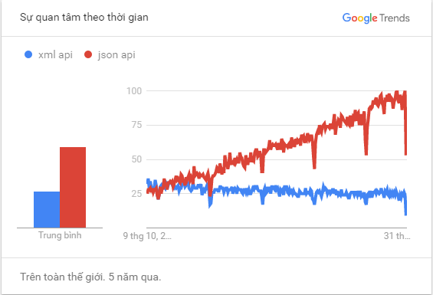
OTHER BEST PRACTICES
  Using json only for response

Slide 20
OTHER BEST PRACTICES
  Always enable Gzip for api
  Handle Cors (Coss-Origin Resource Sharing)
  Allow overriding HTTP method (X-HTTP-Method-Override)

Slide 21
Q & A

Slide 22


